Slide 1
Nystagmus Update
NN Open Day 2017

Slide 2
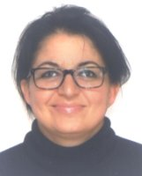
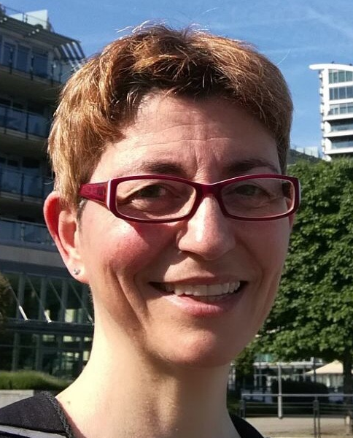
Vijay Tailor
Clinical & Research Orthoptist
PhD student
Maria Theodorou
Ophthalmologist
Paediatrics, Strabismus & Nystagmus
Nadia Venturi
Clinical & Research Orthoptist

Slide 3
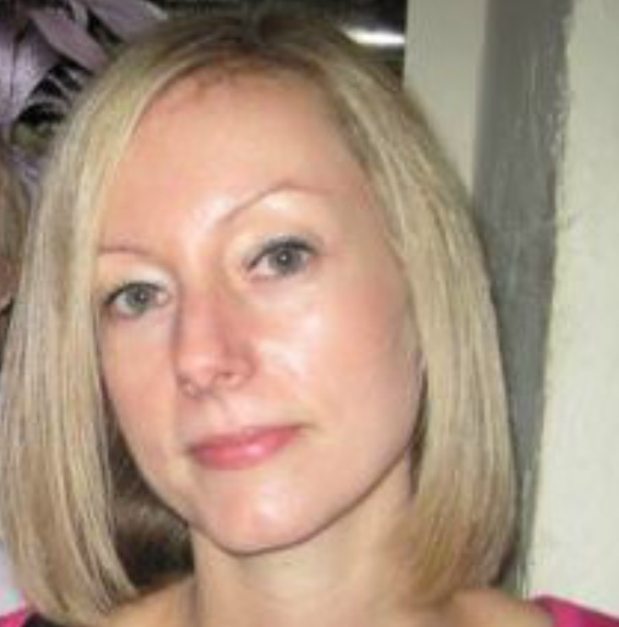
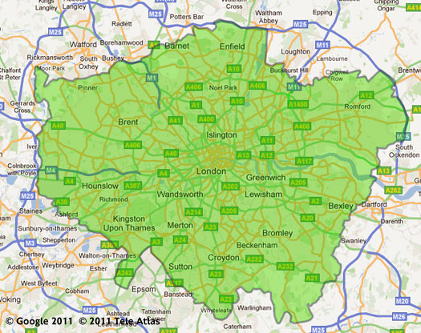
Clinical Services
General paediatric clinics (<16yrs)
Specialist Paeds Nystagmus Clinics (<16yrs)
Adult Strabismus/Nystagmus Clinics (>16yrs)
‘One stop’ opinion
Shared Care
Long term care

Slide 4
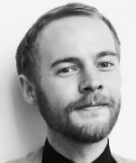
Research – Currently Recruiting
‘Crowding’ in adults with nystagmus (part of PhD)
Institute of Psychology (UCL) & Moorfields
Adults with IINS & no manifest squint
Development of vision &
nystagmus in INS
Moorfields Eye Hospital
Children < 3yrs with IINS
Magnets in Refractory
Acquired Nystagmus
Institute of Neurology,
Oxford University,
Moorfields Eye Hospital
Healthcare Bio Magnetic Clinic

Slide 5
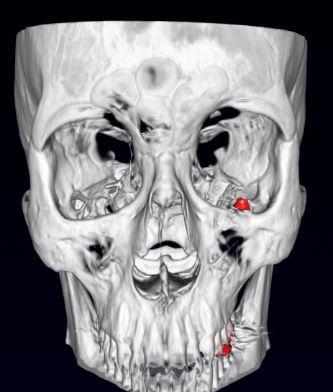
Magnets - Brief
Novel Treatment for vertical nystagmus
In one patient to date, currently recruiting
Only suitable for a small select group (Not IN)
Predominantly vertical nystagmus
Very symptomatic despite maximum medical treatment
Unlikely to require MRI in the future
Good visual function (excluding effects of nystagmus)
No null point

Slide 6
Further/current work includes:
Quality of Life studies
Treatments (incl CLs)
Nystagmus/fixation instability after baby cataract surgery
Further work in progress...

Slide 7
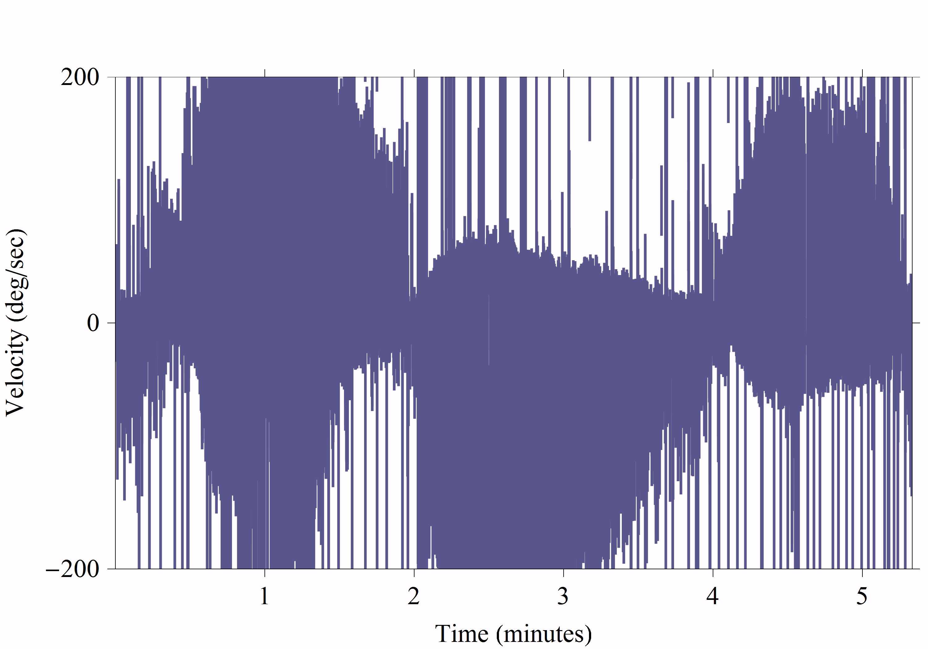
For any queries,
contact directly or via NN

