Slide 1
Raising aspirations: How the system works
Rory Cobb & Sue Keil

Slide 2
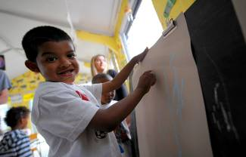
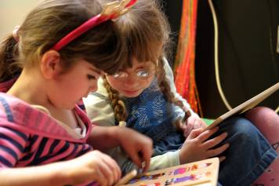
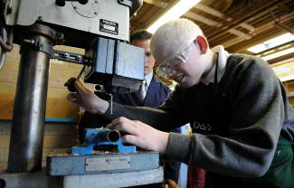

Slide 3
How many CYP with VI are there?
Prevalence of around 2 per 1000
Approximately 25,000 children and young people in the UK from birth to 16
Most are born with their vision impairment
7% of CYP in England and Wales newly certified as SSI/SI for nystagmus and other irregular eye movements in 2014-15 (Bunce, Zekite, Wormald and Bowman, 2017)

Slide 4
Some other facts
Numerically small but very diverse population
At least 50% have other disabilities or special educational needs
Pupils with VI are the highest attaining of all SEN groups

Slide 5
Range of needs
Other special needs
Complex
Significant
Some
None
 | Mild | Moderate | Severe | No vision
 | Extent of vision impairment

Slide 6
What are the main effects on learning?
Incidental learning
Visual concepts
Information processing
Getting around
Practical skills
Social interaction

Slide 7
Who supports children with vision impairment?
Health professionals
Education professionals
Social care professionals

Slide 8
The SEND system – Key elements
2. All duties apply to all state-funded schools and colleges
1. Involvement of children, young people and parents
3. A clear, transparent local offer of services for all CYP with SEND
6. Statutory protections for 16-25s; focus on preparing for adulthood
4. LA, health and care services to commission services jointly
5. Coordinated assessment; 0-25 Education, Health and Care Plan

Slide 9
School placement
Majority in mainstream schools
Nearly all educated within their local authority
Majority of those in special schools are in generic special schools
Very few specialist VI schools, mainly for children with profound and complex needs

Slide 10
Key strategies
Time
People
Resources
Tasks
All require specialist knowledge and understanding = training

Slide 11
Video clips
Primary
Secondary
available in ‘technology and independent learning’ section at www.rnib.org.uk/educationprofessionals
Access to exams
available at www.rnib.org.uk/examaccess

Slide 12
Primary and secondary school
http://www.rnib.orguk/services-we-offer-advice-professionals-education-professionals/technology-education

Slide 13
Access to exams
www.rnib.org.uk/examaccess

Slide 14
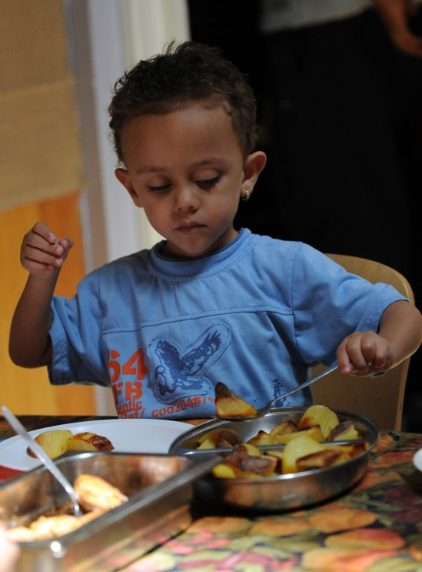
Specialist Curriculum
Independent living skills
Mobility
Communication methods - magnifiers, assistive technology
Social and interpersonal skills

Slide 16
Key outcomes for learners
Learning to access
Use of equipment
Independence and negotiation skills
Participation
Meeting others
Getting around
Looking after him/herself
Life after school

Slide 17
Child’s age / developmental level (Time)
Providing ‘Access to Learning’
Teaching ‘Learning to Access’
Increased independence;
Emphasis upon additional curriculum

Slide 18
VI service organisation and funding
Traditional models
Centrally funded and organised
Partially or wholly delegated to schools
Recent trends
Academies
LA budget cuts
Reduced support for some groups of pupils, including those with mild/moderate needs

Slide 19
Getting children and young people the support they deserve
Alliance of parents, young people and professionals
Campaign to raise awareness of weaknesses in the current system and achieve change
For further information go to:
www.rnib.org.uk/brighterfuturescyp

Slide 20
References
Bunce C, Zekite A, Wormald R and Bowman R (2017) Is there evidence that the yearly numbers of children newly certified with sight impairment in England and Wales has increased between 1999/2000 and 2014/2015? A cross-sectional study. BMJ Open: http://bmjopen.bmj.com/content/7/9/e016888
Learner Outcomes: National Sensory Impairment Partnership (NatSIP)
https://www.natsip.org.uk/
https://www.natsip.org.uk/search-new?q=learner+outcomes&a98136d2a30824dbf8ebda376acf9294=

